Slide 2
NCS 2021: PARI Project
The National Catechetical Study (NCS) 2021:
Pastoral Action Research and Intervention
Studying Catechetical Human Resource (SCHR)

Slide 3
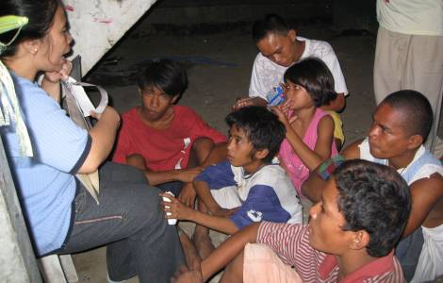
Core of SCHR
The project will address a neglected dimension of the Catechetical Ministry in the Philippines, yet a significant arm of the Church - human resource. The project aims to formulate standard policies on the three dimensions, namely: employment, formation and compensation that could offer sustainability to the Catechetical Ministry of the country, specifically on its Human Resource – Catechists.

Slide 4
Research Design
It fundamentally aims to align a welfare for catechists, which will eventually benefit not only them, but likewise other stakeholders to whom they impart the Catholic values as called by their vocation.
Mixed research design: Qualitative and Quantitative

Slide 5
Main Questions to be Probed
What are the existing policies (if there is any) that Ecclesia territories have at hand that seems inept in the sustainability of the CM?
How does the current practices (or lack thereof of standard policies) affect the sustainability of the program as well as of its HR - catechists?
What is a modest social rate of return for a sustainable CM program using a comprehensive computed compensation equation?
Notes:
PHILOSOPHIES AND PERSPECTIVES (HEARING AND THE DEAF) ARE INTERTWINED

Slide 6
To assess the current system of the Catechetical Ministry on Human Resources in comparison with a typical professional human resource management.
General: To design organizational policies and standards for the welfare of the Catechists in the entire archipelago, which will benefit the Catechetical Ministry and its recipients of the Catholic instructions.
To recommend a reasonable set of policies and standard in relation to continuous training and development of catechists that is essential in sustaining and retaining of human resource.
To formulate/calculate a just and equitable compensation and benefits that is acceptable to both the Church administrators and the catechists.

Slide 7
Mixed Research Design: Grounded and Holistic Perspective
QuaNti
QuaLi
Organizational Structure and Work-Flow Chart
Recent renumeration
Legal compensation
Monetary value on non-income variables
Simple survey (Admin and Catechists)
Narrative (Admin & Catechists)
Social Visual Analysis: Photo-Elicitation
(Respondent-Generated or Researcher-Initiated)
Focused Group Discussion

Slide 8
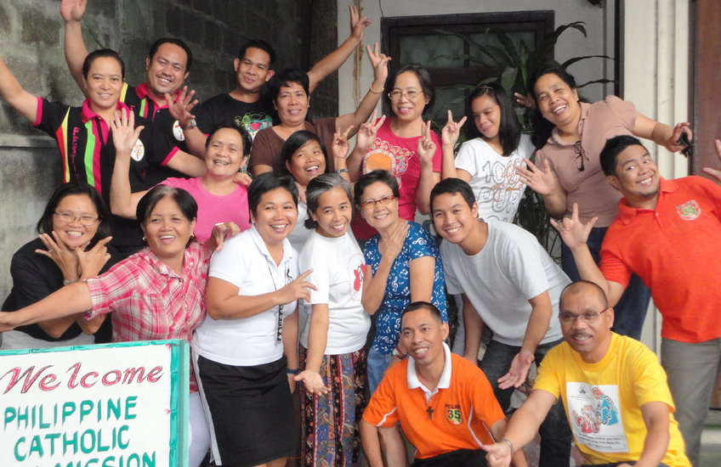
Research Focus
HR Framework
Professionalize Service
Just Welfare
To assess by comparison management, the current system of the Catechetical Ministry on Human Resource with a typical professional human resource
To recommend a reasonable set of policies and standard in relation to continuous training and development of catechists that is essential in sustaining and retaining of human resource.
To formulate/calculate a just and equitable compensation and benefits that is acceptable to both the Church administrators and the catechists.

Slide 9
Significance
A professionalized human resource system of the Catechetical Ministry will equip catechists of needed fundamentals of theology that will directly benefit the stakeholders.
Administrators (ecclesial and Catechetical Ministry) leaders will likewise benefit in this project by indirectly equipping them in human resource management, which is essential in any given organization or office.

Slide 10
Recruitment, Selection etc.
Theological Updating Program
CM Development
(Professional and Organizational)
Acceptable human resource policy, standards and ethics for catechists that will be integrated
Performance Appraisal/Feedback
Compensation and Welfare

