Slide 1
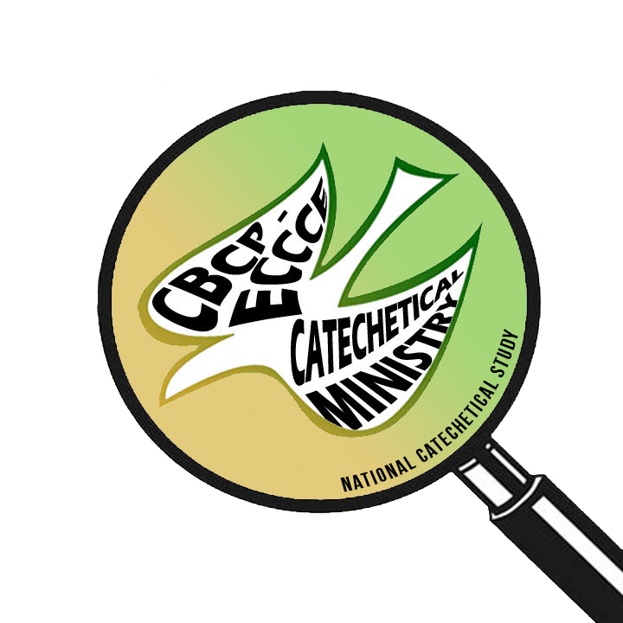
NCS 2021: PARI PROJECT
The National Catechetical Study (NCS) 2021:
Pastoral Action Research and Intervention (PARI) Project
27 February
2019

Slide 2
STUDYING CATECHETICAL CENTERS (SCC) – National Catechetical Study (NCS) 2021: Pastoral Action Research and Intervention (PARI) Project
Name of Proponent & Institution:
Heiden C. Anorico
University of Santo Tomas

Slide 3
Abstract
Studying Catechetical Center (SCC) is a
pastoral action research that aims at producing a historical
documentation of the selected catechetical centers in the country.
It focuses on understanding
the founding and evolution of these catechetical centers;
their formation programs and projects;
catechetical teaching and learning strategies employed; and
curricular challenges and innovation initiatives (and the lack thereof).

Slide 4
Abstract
SCC will utilize historical case study approach of selected catechetical centers representing 17 ecclesiastical provinces.
SCC data will be able to identify
formation;
curricular;
and pedagogical insights

Slide 5
Study Background
Primary church documents on catechetical ministry:
The Catechism of the Catholic Church 1992;
Catholic Bishops' Conference of the Philippines, 1997, 2007;
Compendium of the Catechism of the Catholic Church, 2005.

Slide 6
Study Background
Issues:
How are we addressing the current state of catechetical centers?
Lack of continuing relevant catechetical formation
for training of catechists (with and without community life)
development of appropriate catechetical curriculum
role of technology in formation of catechists (media sources: fb page, apps, other web pages, blogs, etc.)
the physical structure of catechetical centers
leadership in catechetical centers in relation to implementation of catechetical curriculum

Slide 7
Project Concept & Research Focus
Studying Catechetical Centers (SCC) is an in-depth exploration of the
(a) history and development of catechetical centers in the Philippines
(b) review and evaluate the catechetical curriculum and instruction utilized
in the catechetical centers.

Slide 8
Project Concept & Research Focus
Understanding the historical background of catechetical centers in the Philippines, its projects and programs
Assessment of existing catechetical curriculum and instruction applied in the catechetical centers

Slide 9
Project Concept & Research Focus
The main points of empirical inquiry are the following:
How did catechetical centers started and evolved in the Philippines through the years?
Who are the chief catechetical leaders and what are their significant contributions that shaped the catechetical centers?
What are the catechetical formation programs and projects and how did it strengthen (or weaken) the current catechetical ministry today?
What is the current status of catechetical curriculum and instruction implementation in the catechetical centers?
How did changes in technological development affect the implementation of curriculum and instruction in the catechetical centers?
What research insights from catechetical historical background, programs and project, and current catechetical curriculum and instruction can be applied to create pastoral intervention activities for effective catechetical ministry?

Slide 10
Working Literature Review
Catechetical centers
Historical documents of catechetical centers
Catechetical formation projects and programs
Catechetical curriculum
Catechetical methods
Catechist formation (with and without community life)
Technological development
Leadership (catechetical leaders)
Formation on pastoral and evangelizing communication for catechetical leaders

Slide 11
Theoretical Lens
Theoretical frames that will guide this research are:
Complementary Theory of Documents (Lund, 2009)
Combination of Curriculum design framework (Ornstein and Hunkins, 2009) & Outcomes Based Education (Tucker, 2004)

Slide 12
Research Strategies
Mixed-method. Quantitative and qualitative data will be analyzed using computer-assisted software. Tables, graphs, themes and conceptual maps will be used for data presentations.
Historical case study approach (Widdersheim, 2018)
Combination of Ornstein and Hunkins’ (2009) curriculum design framework & Outcomes-based education (Tucker, 2004)

Slide 13
Research Strategies
Mixed-method. Quantitative and qualitative date will be analyzed using computer-assisted software. Tables, graphs, themes and conceptual maps will be used for data presentations.
Historical case study approach (Widdersheim, 2018)
source collection and analysis; data collection and analysis; and data interpretation, wherein each stage has its own methods, tasks and results
Ornstein and Hunkins’ (2009) curriculum design framework & Outcomes-based education (Tucker, 2004)
data collection, needs assessment and analysis
Creative and visual methodologies (Gauntlett, 2005)

Slide 14
Significance of the Study
Translating research insights will contribute to the
creation and development of policies, guidelines and strategies to improve the current state of catechetical centers.
contribute to the development of intervention activities to update curriculum and instruction utilized in the formation of the catechist.

Slide 15
Expected Outputs
Literature review
Historical/archival documents
Interview data
Case study data
Curriculum data
Photos, web images (for visual presentation)
Quantitative and qualitative results collection
Presentation to stakeholders
Conference
Journals
Curriculum for Catechetical formation
For visual presentation of Catechetical Centers (ex. Coffee table book; digital storytelling)

Slide 16
Working Bibliography
The Catechism of the Catholic Church (1992). Vatican City: Libreria Editrice Vaticana.
Catholic Bishops' Conference of the Philippines. (1997). Catechism for Filipino Catholics. Manila: Episcopal Commission on Catechesis and Catholic Education & Word & Life Publications.
Catholic Bishops' Conference of the Philippines. (2007). National Catechetical Directory for the Philippines. Manila: Catholic Bishops Conference of the Philippines.
Compendium of the Catechism of the Catholic Church. (2005). Vatican City: Libreria Editrice Vaticana.
Gauntlett, D. (2005). Using Creative Visual Research Methods to Understand Media Audiences. MedienPädagogik: Zeitschrift für Theorie Und Praxis Der Medienbildung, 9, 1-32. https://doi.org/10.21240/mpaed/09/2005.03.29.X
Lund, N. W. (2009). Document theory. Annual Review of Information Science and Technology, 43(1), 1– 55.doi:10.1002/aris.2009.1440430116
Macayan, J. (2017). Implementing Outcome-Based Education (OBE) Framework: Implications for Assessment of Students’ Performance. Educational Measurement and Evaluation Review, 8(1), 1-10.
Ornstein, A., & Hunkins, F. (2009) Curriculum Design. In Curriculum: Foundations,
Principles and Issues (5th Ed.), pp. 181-206. Boston, MA: Pearson/Allyn and Bacon.
Widdersheim, M. (2018). Historical case study: A research strategy for diachronic analysis. Library & Information Science Research, 40, 144-152. doi:10.1016/j.lisr.2018.06.003

